Slide 1
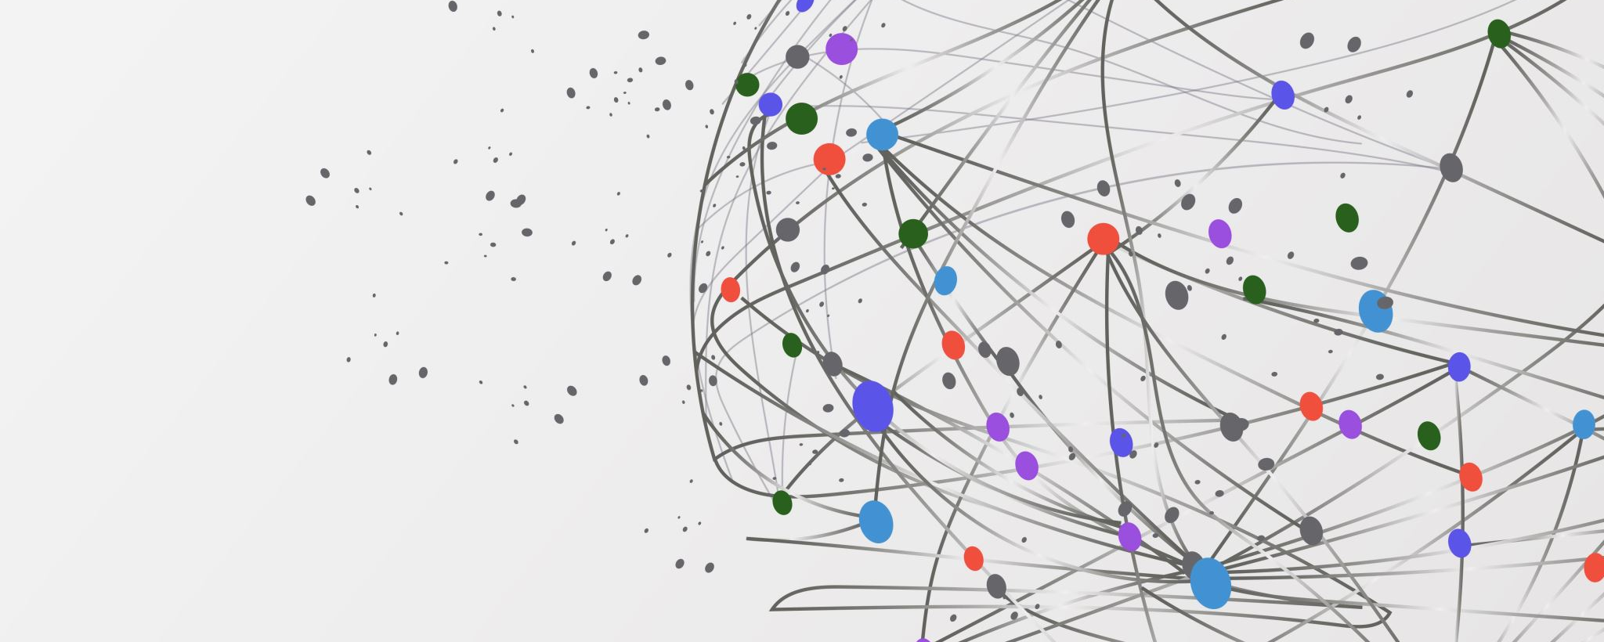
Capstone Project
DSCI 2 - Eric Sorensen
Liam Fisher

Slide 2
Topic and Context
1 in 9 Americans older than 65 have Alzheimer’s dementia
Treatment in the United States cost $305 billion in 2020
Proper diagnosis is very expensive.
12.5 million projected to have Alzheimer’s dementia by 2050
Disease still not fully understood
There is evidence that Alzheimer’s has certain gene expressions: https://www.nia.nih.gov/news/gene-expression-signatures-alzheimers-disease

Slide 3
Objective
See how well Gene Expression Data can be used to predict Alzheimer’s Dementia.
2. Discover Gene Expressions that are related to Alzheimer’s Dementia.

Slide 4

Data

Slide 5

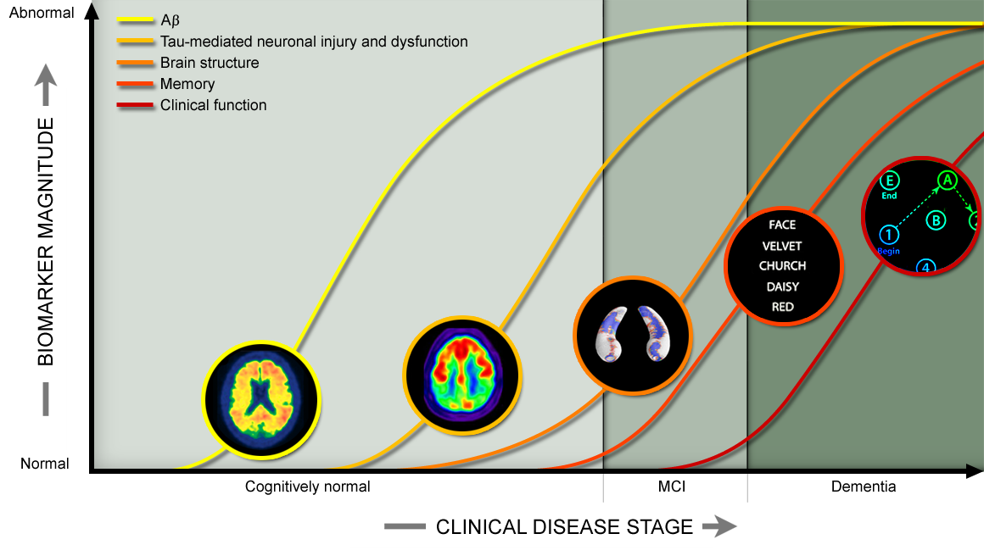

Slide 6
Data
STUDY CHARACTERISTICS | ADNI-1 | ADNI-GO (Grand Opportunities) | ADNI-2 | ADNI-3
Primary goal | Develop biomarkers as outcome measures for clinical trials | Examine biomarkers in earlier stages of disease | Develop biomarkers as predictors of cognitive decline, and as outcome measures | Study the use of tau PET and functional imaging techniques in clinical trials
Funding | $40 million federal (NIA), $27 million industry and foundation | $24 million American Recovery Act funds | $40 million federal (NIA), $27 million industry and foundation | $ 40 million federal (NIA), up to $20 million industry and foundation
Duration/start date | 5 years/October 2004 | 2 years/September 2009 | 5 years/September 2011 | 5 years/September 2016

Slide 7
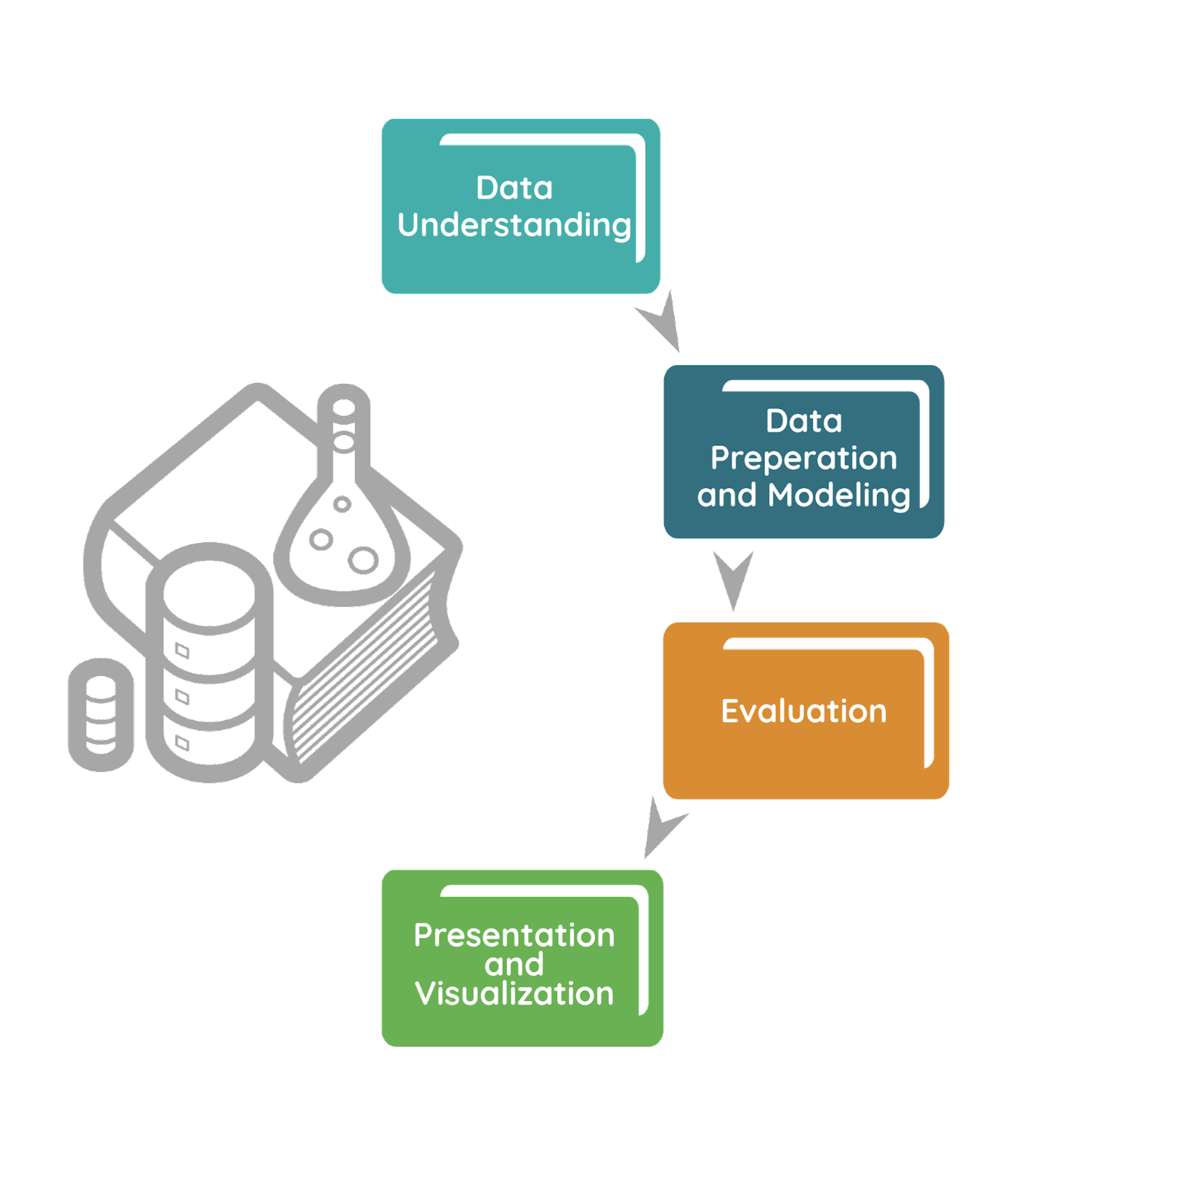
Predicting Alzheimer’s

Slide 8
Data Understanding
Number of Participants in Data: 774
Number of Genetic Expressions: 49390
Patient Classifications: CN, MCI, AD

Slide 9
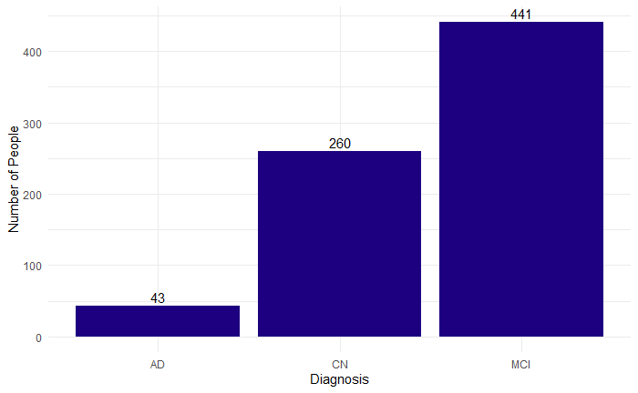
Data Understanding

Slide 10
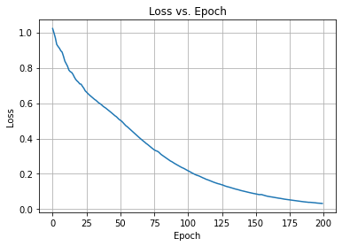
Data Prep and Modelling
Due to the large number of gene expressions (49,390), the amount of gene expressions must be reduced prior to modelling.
PCA Autoencoder Locally Linear
(99% variance at Embedding
by 556 components)

Slide 11
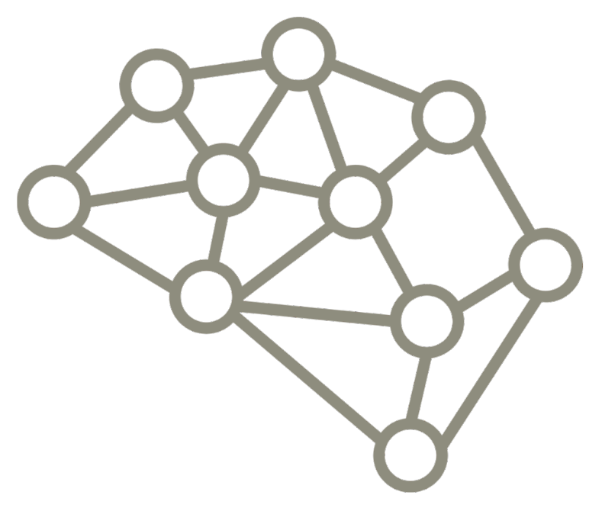
Data Prep and Modelling
Models Tried:
Multilayer Perceptron
Random Forest
ExtraTree Classifier
Support Vector Machine Classifier
Voting Ensemble Classifier (RF, ExTree, SVC)

Slide 12

Data Prep and Modelling
Each Reduce Dataset
Used for Each Model below.
GridSearchCV() for:
RF
Extra Trees
SVC

Slide 13
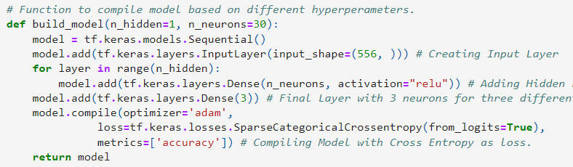
Custom Tuning for MLP
tf.keras.wrappers.scikit_learn - Used for Tuning MLP
Each Reduced Dataset also Used

Slide 14
Evaluation The best model was the ExtraTree Classifier
 | CN | MCI | AD
Accuracy | 23% | 75% | 0%

Slide 15
Evaluation Disparity Similar to Data Disparity

Slide 16
Evaluation Explanation 1. Too little data. 2. Too little data in some target classes. 3. Too much disparity in target classes. 4. Genetic Data Not Sufficient for Diagnosis

Slide 17
Deeper Analysis
Discover Gene Expressions that are related to Alzheimer’s Dementia.

Slide 18
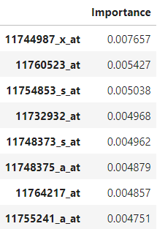
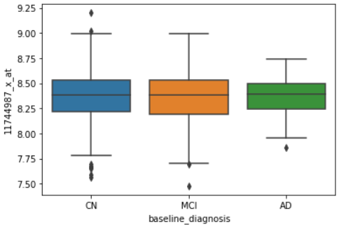
RF Feature Importance’s (Python)

Slide 19

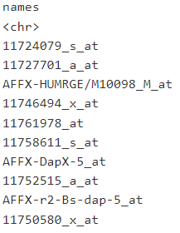
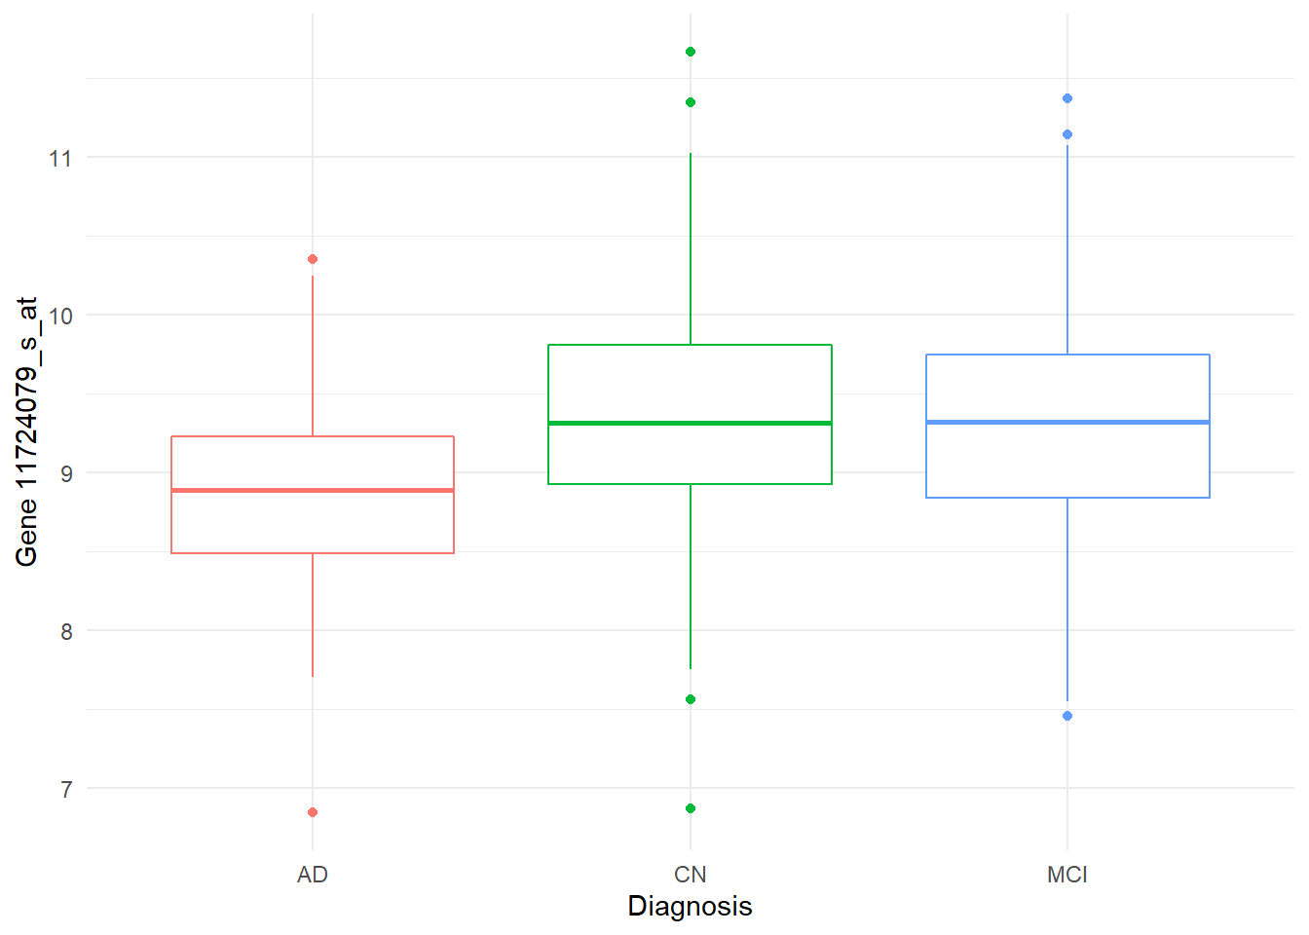
Repeated ANOVA (R)

Slide 20
Conclusion
The ADNI Blood Gene Expression Dataset is not sufficient for the prediction of Alzheimer’s.

Slide 21
References / Resources
https://www.nature.com/articles/s41598-020-60595-1#Sec2
http://adni.loni.usc.edu/
https://www.nia.nih.gov/news/gene-expression-signatures-alzheimers-disease
https://docs.google.com/presentation/d/1ToU7-S_ShdAhbCs9ZFx4a9gGBNC5imRw-_5rznGWOaw/edit
http://adni.loni.usc.edu/about/#core-container
https://dss.niagads.org/studies/sa000002/
https://docs.google.com/presentation/d/1ToU7-S_ShdAhbCs9ZFx4a9gGBNC5imRw-_5rznGWOaw/edit#slide=id.g35f391192_00

